Slide 1
UIU NEXUS -Alumni & Student Community-

Slide 2
Our Team
Taiyaba Taskin ID: 011162063
Md Sazzad Mazumder ID: 011201285
Rasel Ahmed ID:011182001
Md Atik Sahriare ID: 011191235

Slide 3

INTRODUCTION
‘‘We are bringing a new platform to find a career path under the guidance of Alumni of our university’’
Our aim is to build a digital connection with newly graduates & Alumni of your university which will help us to find a career path & get necessary guidance from alumni who are from respective fields.

Slide 4

MOTIVATION
Lack of professional perspective.
Difficulty to find mentors of respective fields.
Lack of common platform to interact for building up a community.
Difficulty to find related job circular.
Scattered alumni community.
Hardship to support career development because of less interaction.
Decreased alumni engagement due to lack of common platform.

Slide 5
Our Features:
1. Login & Registration
2.Add Event(Admin + Volunteer)
3. Job Post(Alumni)
4. Apply for Job(Student + Alumni)
5. Raise Fund(Alumni+ Student)
6. Spending Fund Details( Can See Everyone)
7. Regional and Post wise Alumni Search
8. Gallery
9. Connect through chat
Notes:
© Copyright PresentationGO.com – The free PowerPoint template library

Slide 6
Our Contribution:
Taiyaba Taskin
Login & Registration
Add Event(Admin + Volunteer)
Gallery
Rasel Ahmed
Raise Fund(Alumni+ Student)
Spending Fund Details
Md Sazzad Mazumder
Job Post(Alumni)
Apply for Job(Student + Alumni)
Md Atik Sahriare
Regional and Post wise Alumni Search
Connect through chat
Notes:
© Copyright PresentationGO.com – The free PowerPoint template library

Slide 7

Languages & Platform HTML CSS PHP Mysql Bootstrap JavaScript XAMPP VS Code

Slide 8
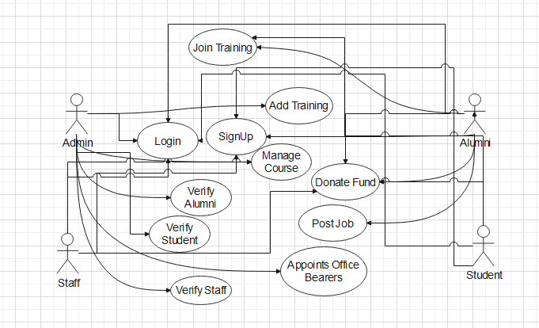
Use Case Diagram

Slide 9
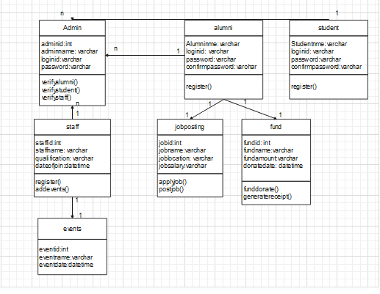
Class Diagram

Slide 10
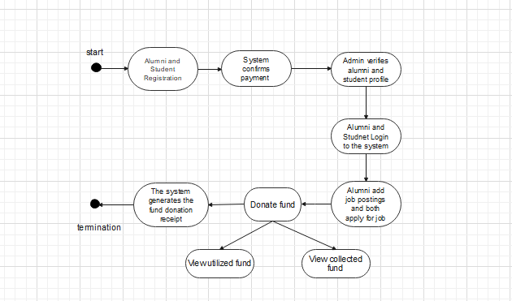
Activity Diagram

Slide 11
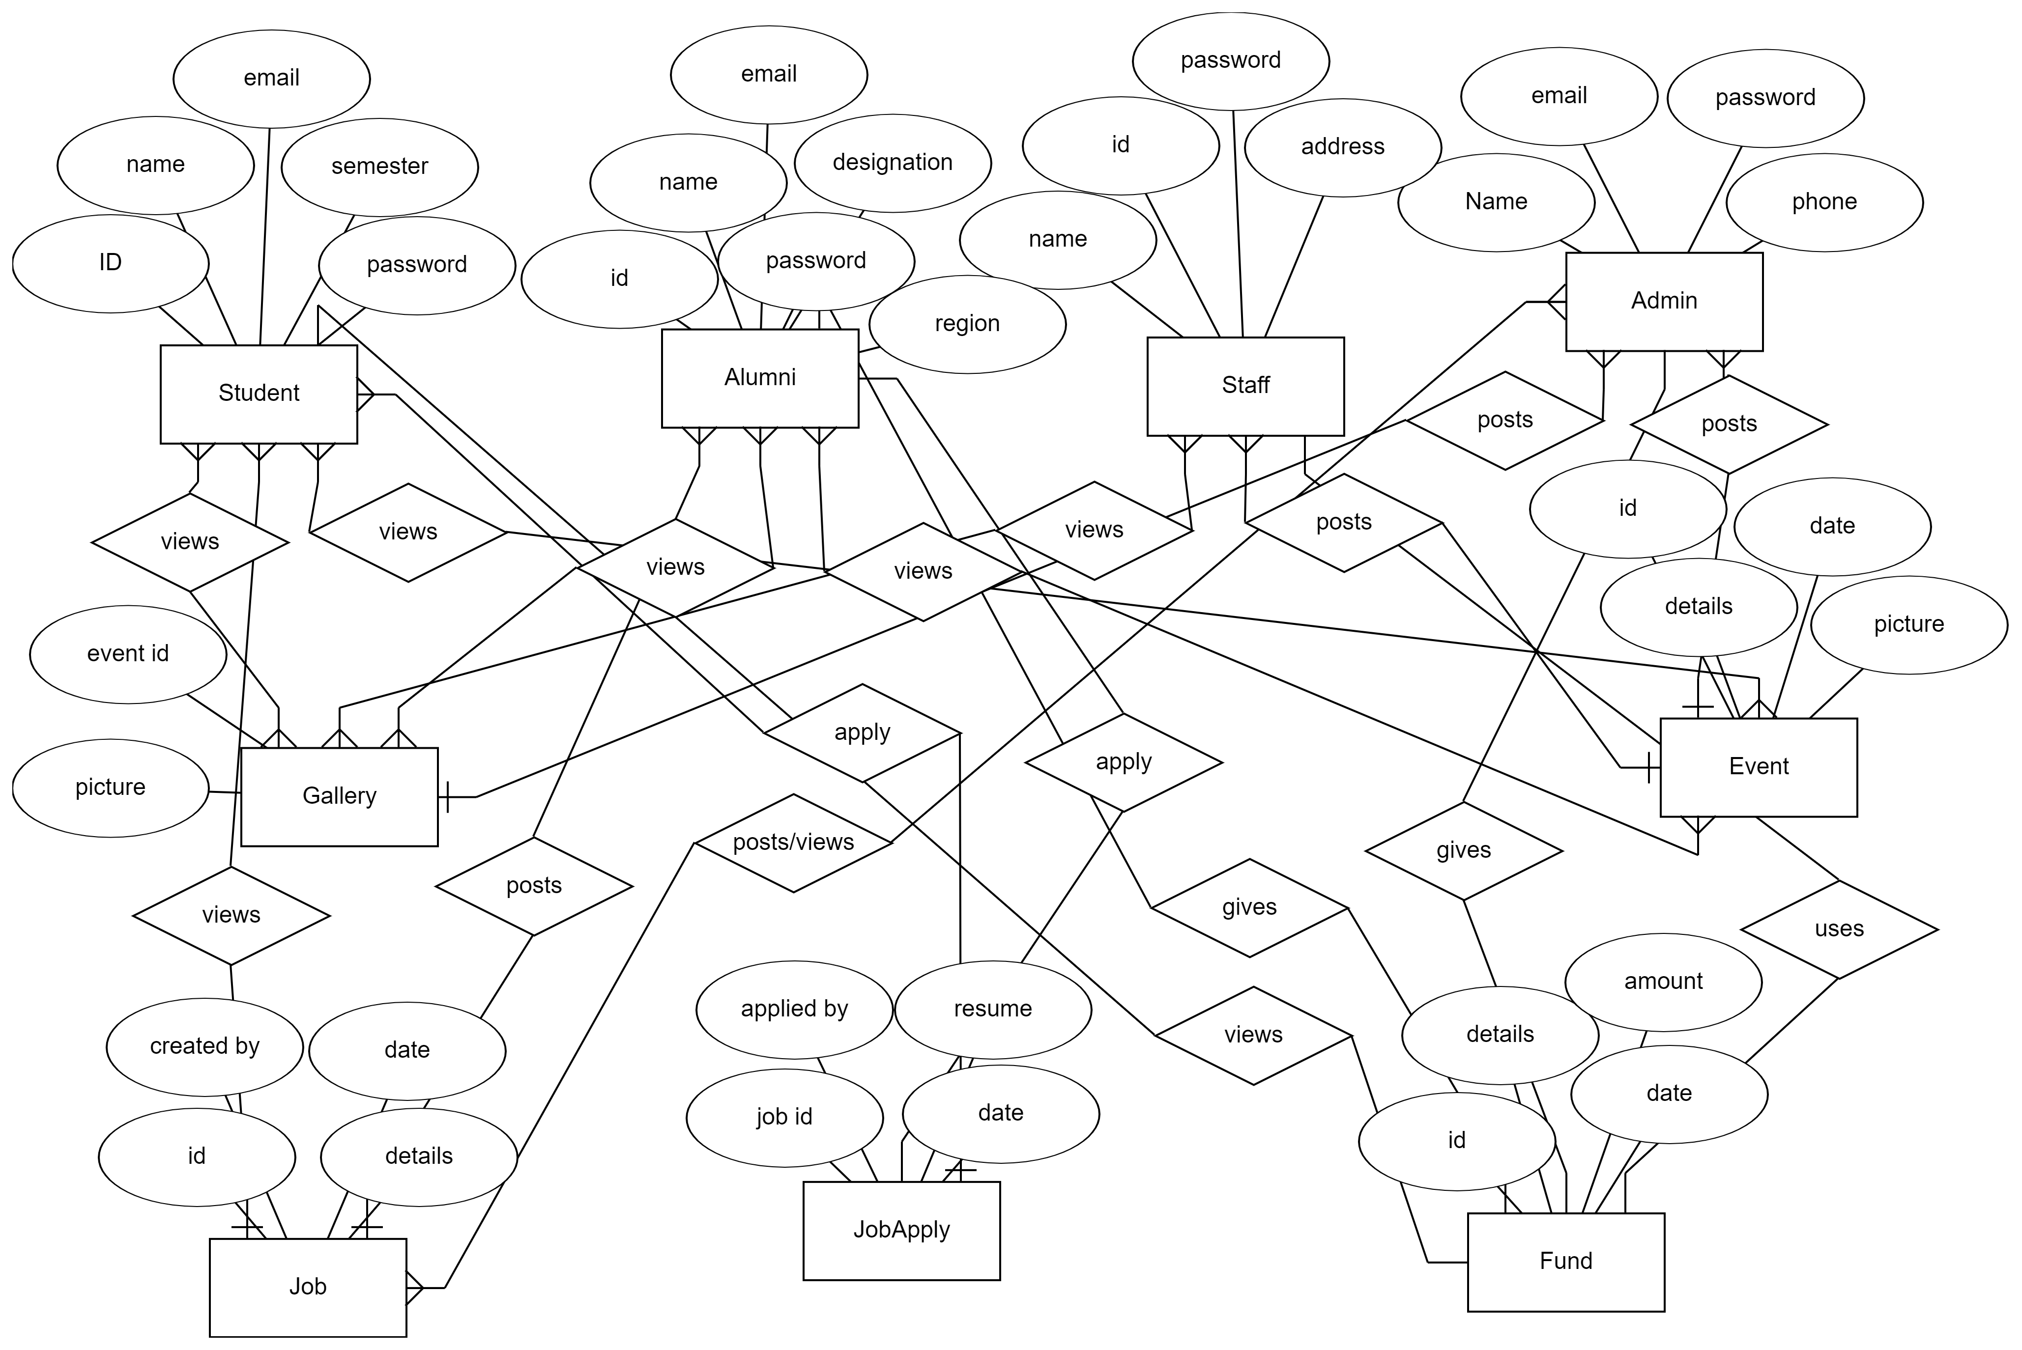
ER Diagram

Slide 12
Git Commits
Md Sazzd Mazumder

Slide 13
Git Commits
Taiyiba Taskin

Slide 14
Git Commits
Atik Shahrear

Slide 15
Git Commits
Rasel Ahmed

Slide 16
UIU Nexus :
Your network to success

